Slide 1


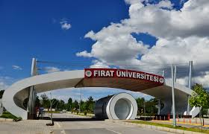
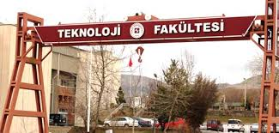
Software Engineering Department
Technology Faculty

Slide 2
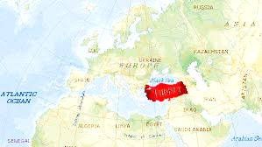
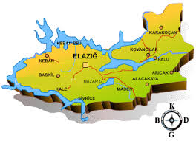

Slide 3
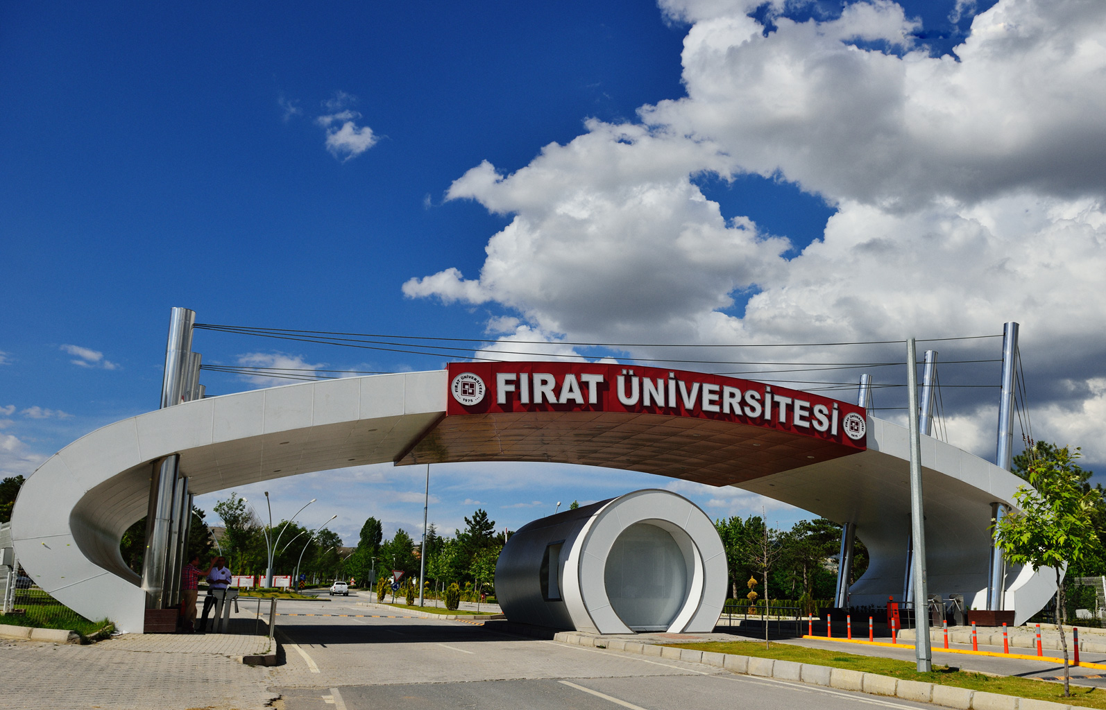
Our Beloved University – Quick Glance

Slide 4

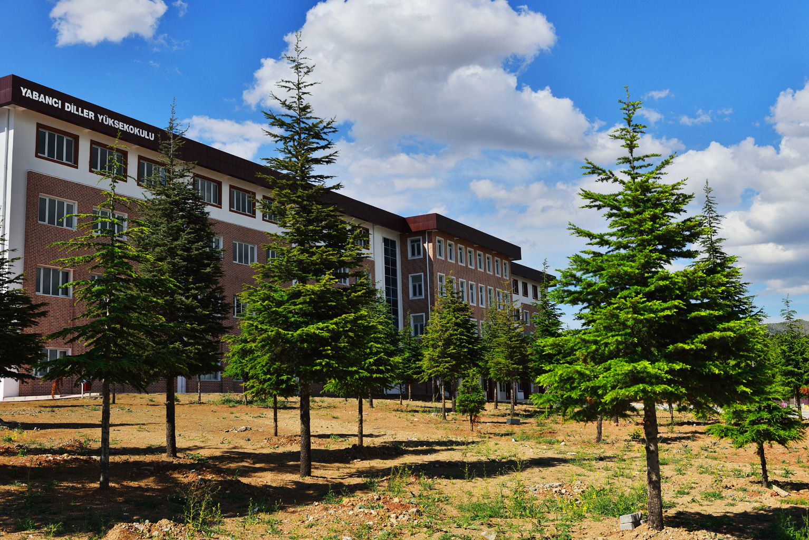
Our Beloved University – Quick Glance

Slide 5
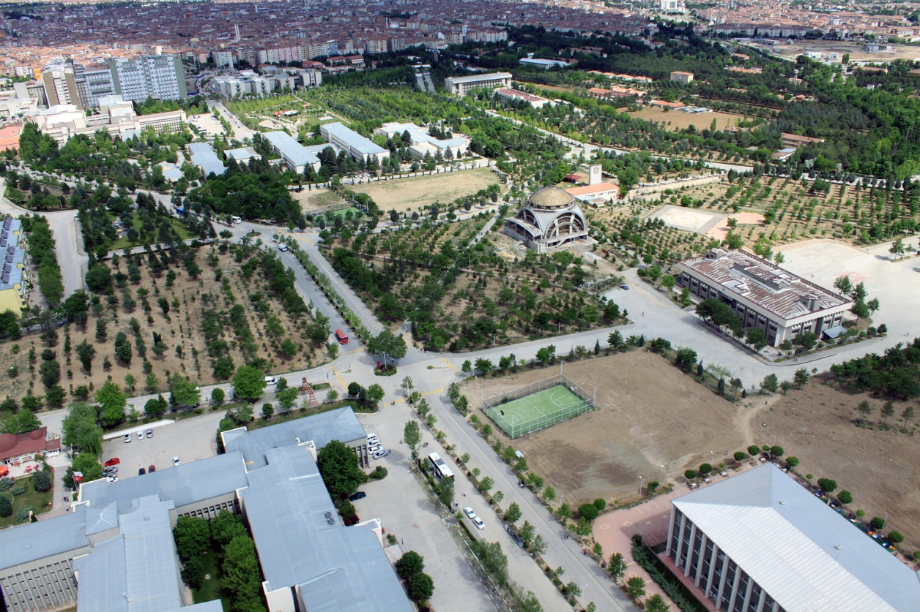
Our Beloved University – Quick Glance

Slide 6
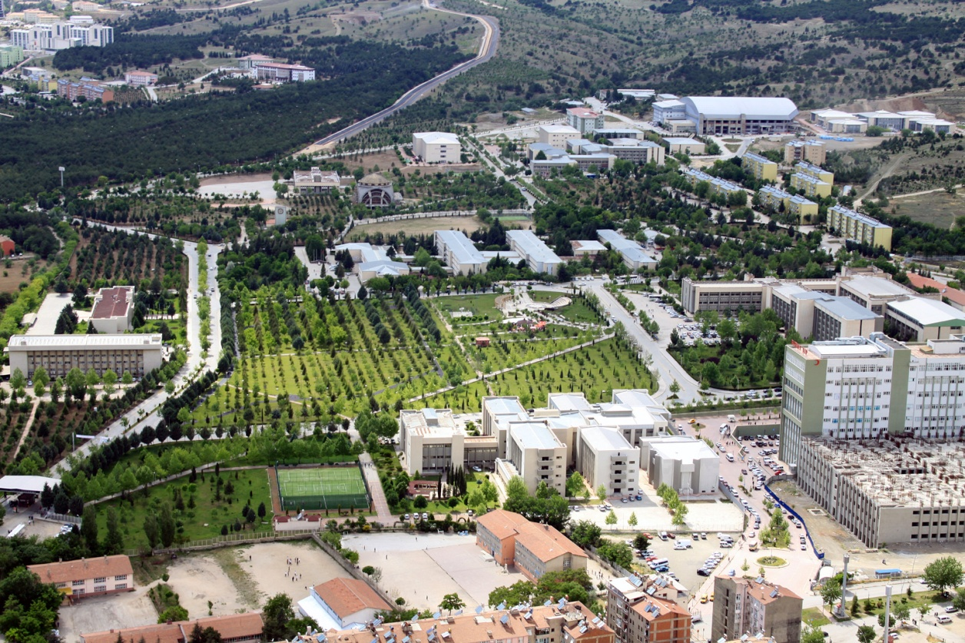
Our Beloved University – Quick Glance

Slide 7
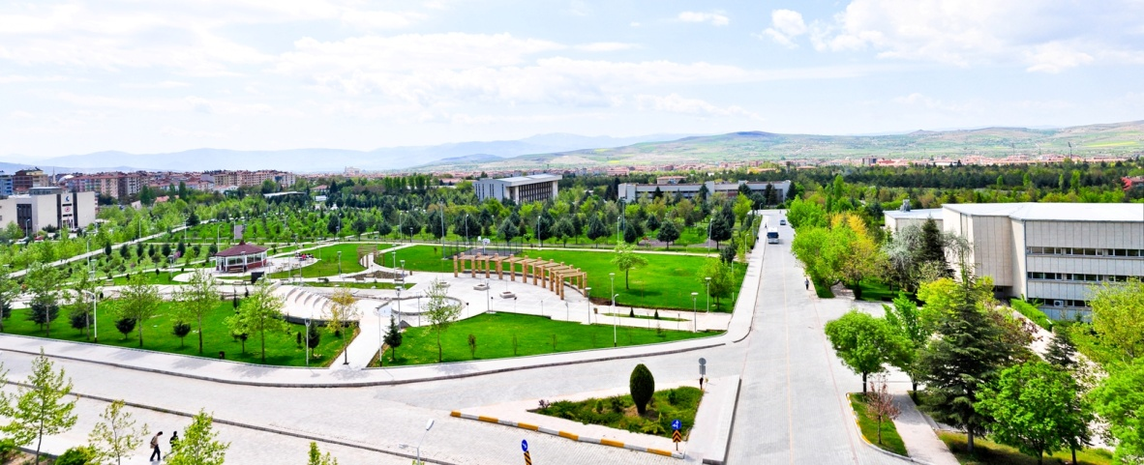
Our Beloved University – Quick Glance

Slide 8
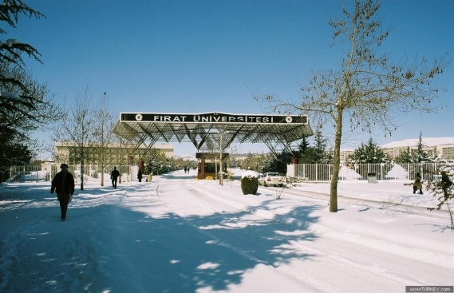


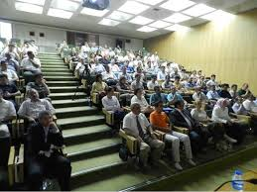

Firat University – Facts & Figures
Was founded in 1975.
Located in Elazig, south-east of Turkey.
14 Faculties, 4 Institutes, 4 Graduate Schools, 9 Vocational Schools, 4 Departments affiliated to the Rectorate.
325 Professors, 200 Associate Professors,
355 Assistant Professors, and 900 Lecturers
and other academic staff
1535 Administrative staff
26041 Undergraduate students – 196 Internationals
3553 Postgraduate students – 99 Internationals

Slide 9
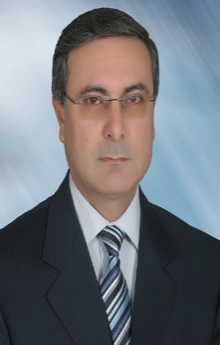
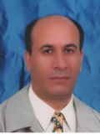
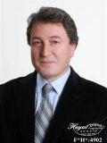

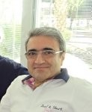
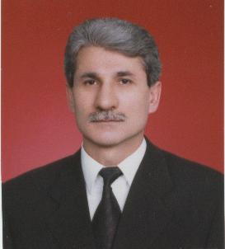
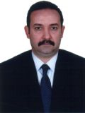
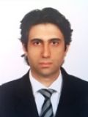
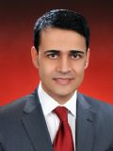

Technology Faculty
Dean
Prof. Dr. Hanifi GÜLDEMİR
Established in 2009
9 Distinguished Departments
9th place according to Turkish
university ranking in 2015.
Energy Systems Engineering
Department Chairman
Prof. Dr. Mehmet ESEN
Mechanical Engineering
Department Chairman
Prof. Dr. Ahmet HASÇALIK
Metallurgy & Material Engineering
Department Chairman
Prof. Dr. Niyazi Özdemir
Software Engineering
Department Chairman
Prof. Dr. Asaf VAROL
Electric-Electronic
Department Chairman
Prof. Dr. Muammer GÖKBULUT
Civil Engineering
Department Chairman
Prof. Dr. U. Teoman AKSOY
Mechatronics Engineering
Department Chairman
Assoc. Prof. Dr. Ahmet Koca
Automotive Engineering
Department Chairman
Prof. Dr. Yasin VAROL
Department of Digital Forensics
Department Chairman
Assoc. Prof. Dr. Mustafa KAYA

Slide 10
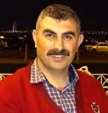
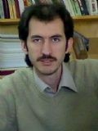
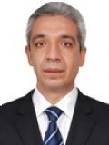
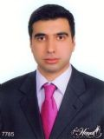
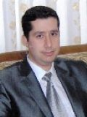
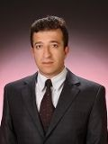
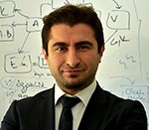
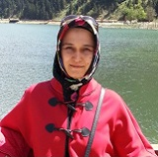
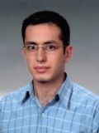
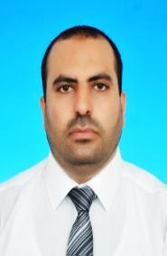
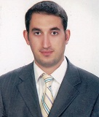
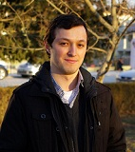
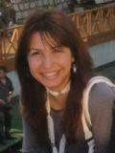
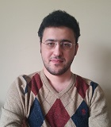
Software Engineering Department
Chairman
Prof. Dr. Asaf VAROL
Vice-Chairman
Assoc. Prof. Dr. Resul DAŞ
Vice-Chairman
Assist. Prof. Dr. Murat KARABATAK
Prof. Dr.
İbrahim TÜRKOĞLU
Prof. Dr.
Engin AVCI
Assoc. Prof. Dr.
Bilal ALATAŞ
Assoc. Prof. Dr.
Erkan TANYILDIZI
Assist. Prof. Dr.
Mustafa ULAŞ
Assist. Prof. Dr.
Seda TUNCER
Res. Assist. Dr.
Fatih ÖZKAYNAK
Lecturer
Malek HARBAWI
Res. Assist.
Muhammet BAYKARA
Res. Assist.
Zafer GÜLER
Res. Assist.
Nilay YILDIRIM
Res. Assist.
Osman ALTAY

Slide 11
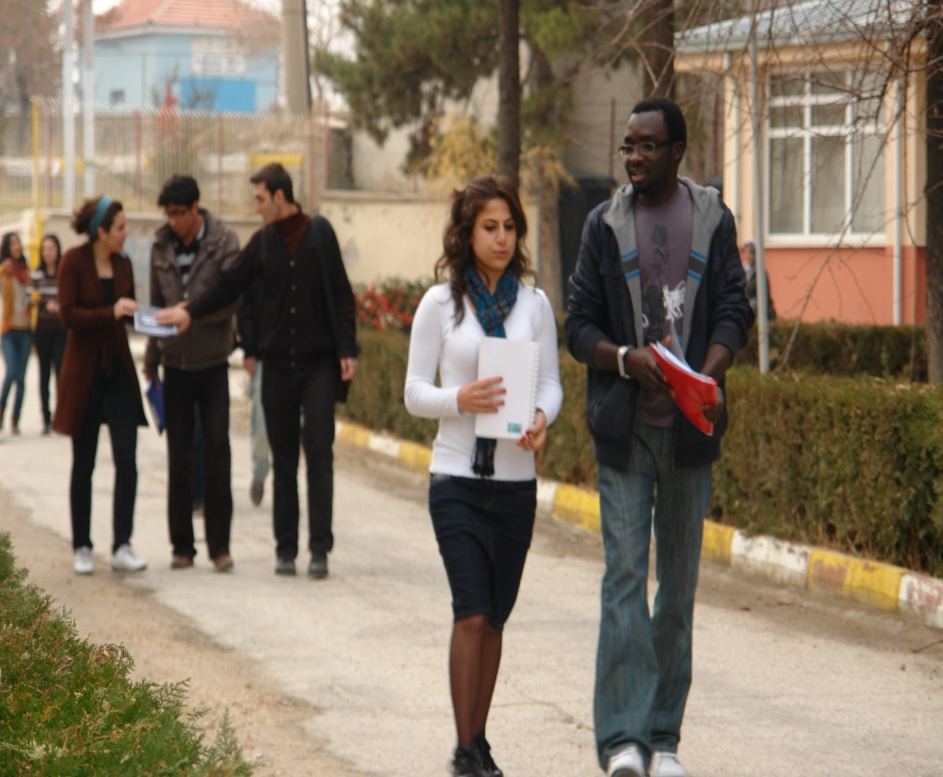
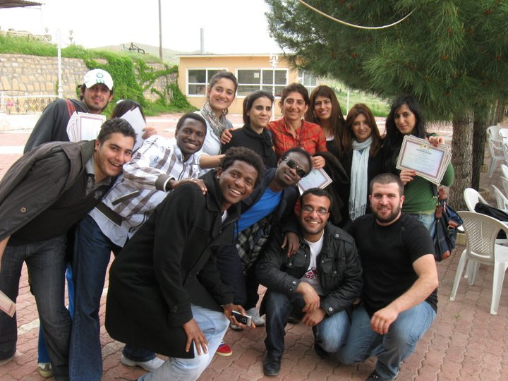
Software Engineering Department – Cont…
Facts & Figures (Programs & Students)
Established in 2009.
61 Graduate students – 15 Internationals (up to Spring sem. 2015).

Slide 12
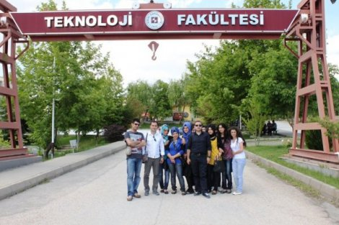
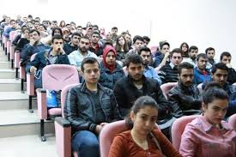
Software Engineering Department – Cont…
Facts & Figures (Programs & Students – Cont…)
Two main streams of Undergraduate studies:
  General High School (without foundation) – 642 students.
  Technical Vocational High School (with foundation) – 104 students.
  Two streams, normal &
  night education.

Slide 13
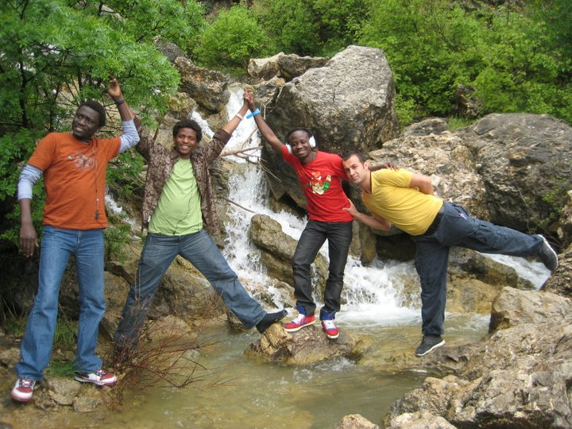
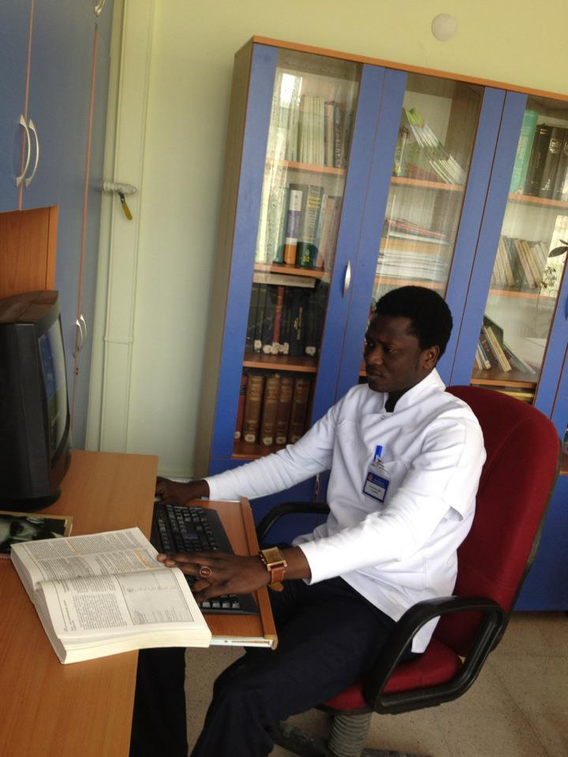
Software Engineering Department – Cont…
Facts & Figures (Programs & Students – Cont…)
Dual Degree Program (UOLP- Sam Houston State University):
  Established in 2012; In collaboration with Sam Houston State University (SHSU).
  1(English Preparatory Level) + 2 (FU) + 2 (SHSU).
  88 students (up to spring sem. 2015).
  Dual certificates are granted upon accomplishing the program.

Slide 14

Software Engineering Department – Cont…
Facts & Figures (Programs & Students – Cont…)
For local students, to get enrolled under SED, the candidate posses either general high school certificate or technical vocational high school certificate, and passing the university entrance exams (YGS-LYS).
Founded in 1973, ÖSYM is
the body responsible for
organizing the national
level university entrance
examination YGS-LYS, and several other large scale
examinations in Turkey.

Slide 15
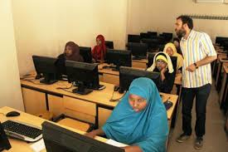
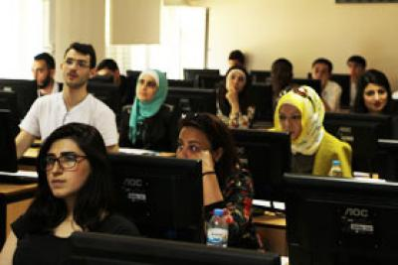
Software Engineering Department – Cont…
Facts & Figures (Programs & Students – Cont…)
There is also quota constrain as follows:
  66 seats for normal education – (3 for International candidates).
  66 seats for second education - (3 for International candidates).
  40 seats for UOLP-SHSU - (10 for International candidates).
For international candidates, there are three exams can be considered as equivalent to university entrance exam, namely FUYOS, SAT1 and E-KUNIB.

Slide 16


Software Engineering Department – Cont…
Facts & Figures (Facilities & Industrial Collaborations)
The Department is furnished with FOUR computer labs.
The labs are equipped by 40 computers provided with all needed specialized software sets (full license from Microsoft).
Industrial Collaboration:
  Two (Summer Session) Internship.
  Practical Training in the last year (Spring/Fall sem) – Key difference from Engineering Faculty Programs.
  The collaboration is mainly with:
    Triodor – Specialized in software solutions.
    Kentkart – Specialized in software solutions for
    transportations’ “smart card”.

Slide 17










Software Engineering Department – Cont…
Facts & Figures (Academic Collaborations)
UG Dual Degree with SHSU.
Mutual Agreements for Exchange Students
with the following universities:
  University of Arkansas – USA.
  West Virginia University – USA.
  Wilkes University – USA.
  TELUQ – Canada.
  McMaster University – Canada.
  University of Sunderland – UK.
  University of Bradford – UK.
  Petru Maior University – Romania.
  Polytechnic Institute of Cavado Ave
  – Portugal.

Slide 18
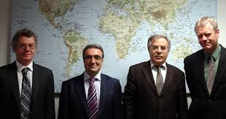
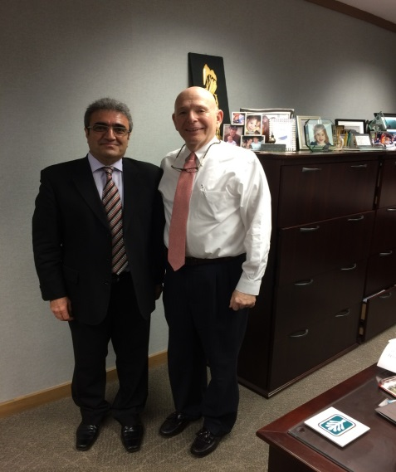
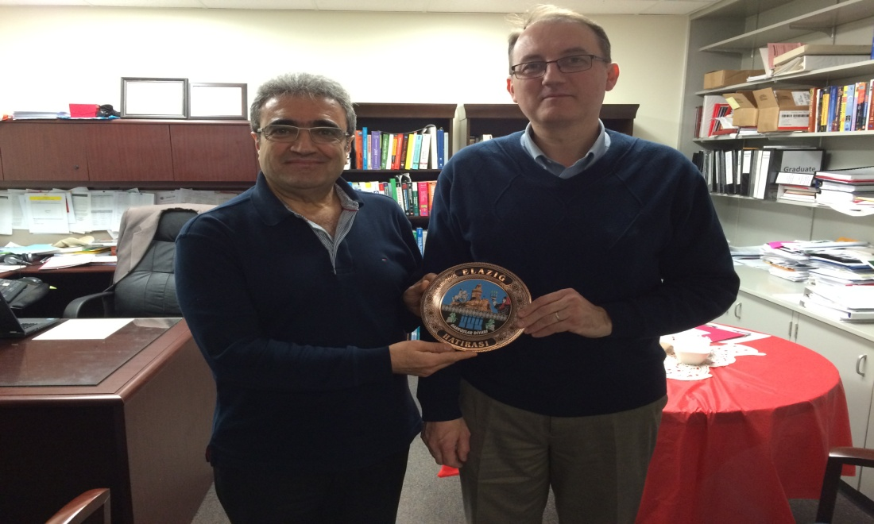
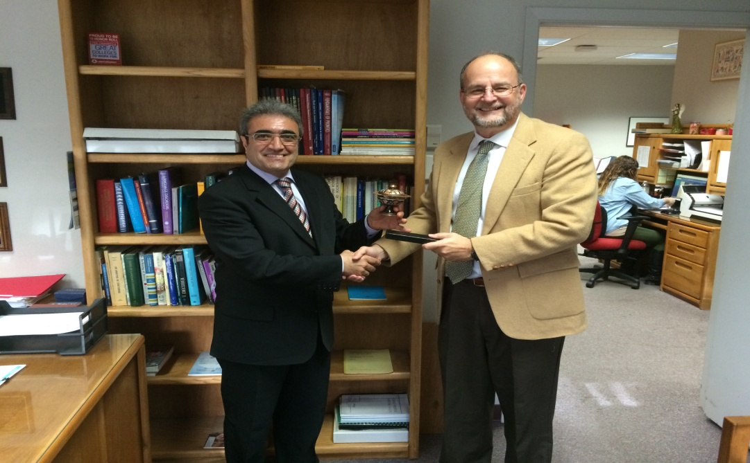
Software Engineering Department – Cont…
Facts & Figures (Academic Collaborations – Cont…)

Slide 19

Software Engineering Department – Cont…
Proposed Collaboration Agenda
Dual Degree program in Computer Science.
Organizing Symposium a Consortium Member.
Exchange Program.
Memorandum of Understanding (MoU).
Collaborate in the graduate studies.

